Slide 1
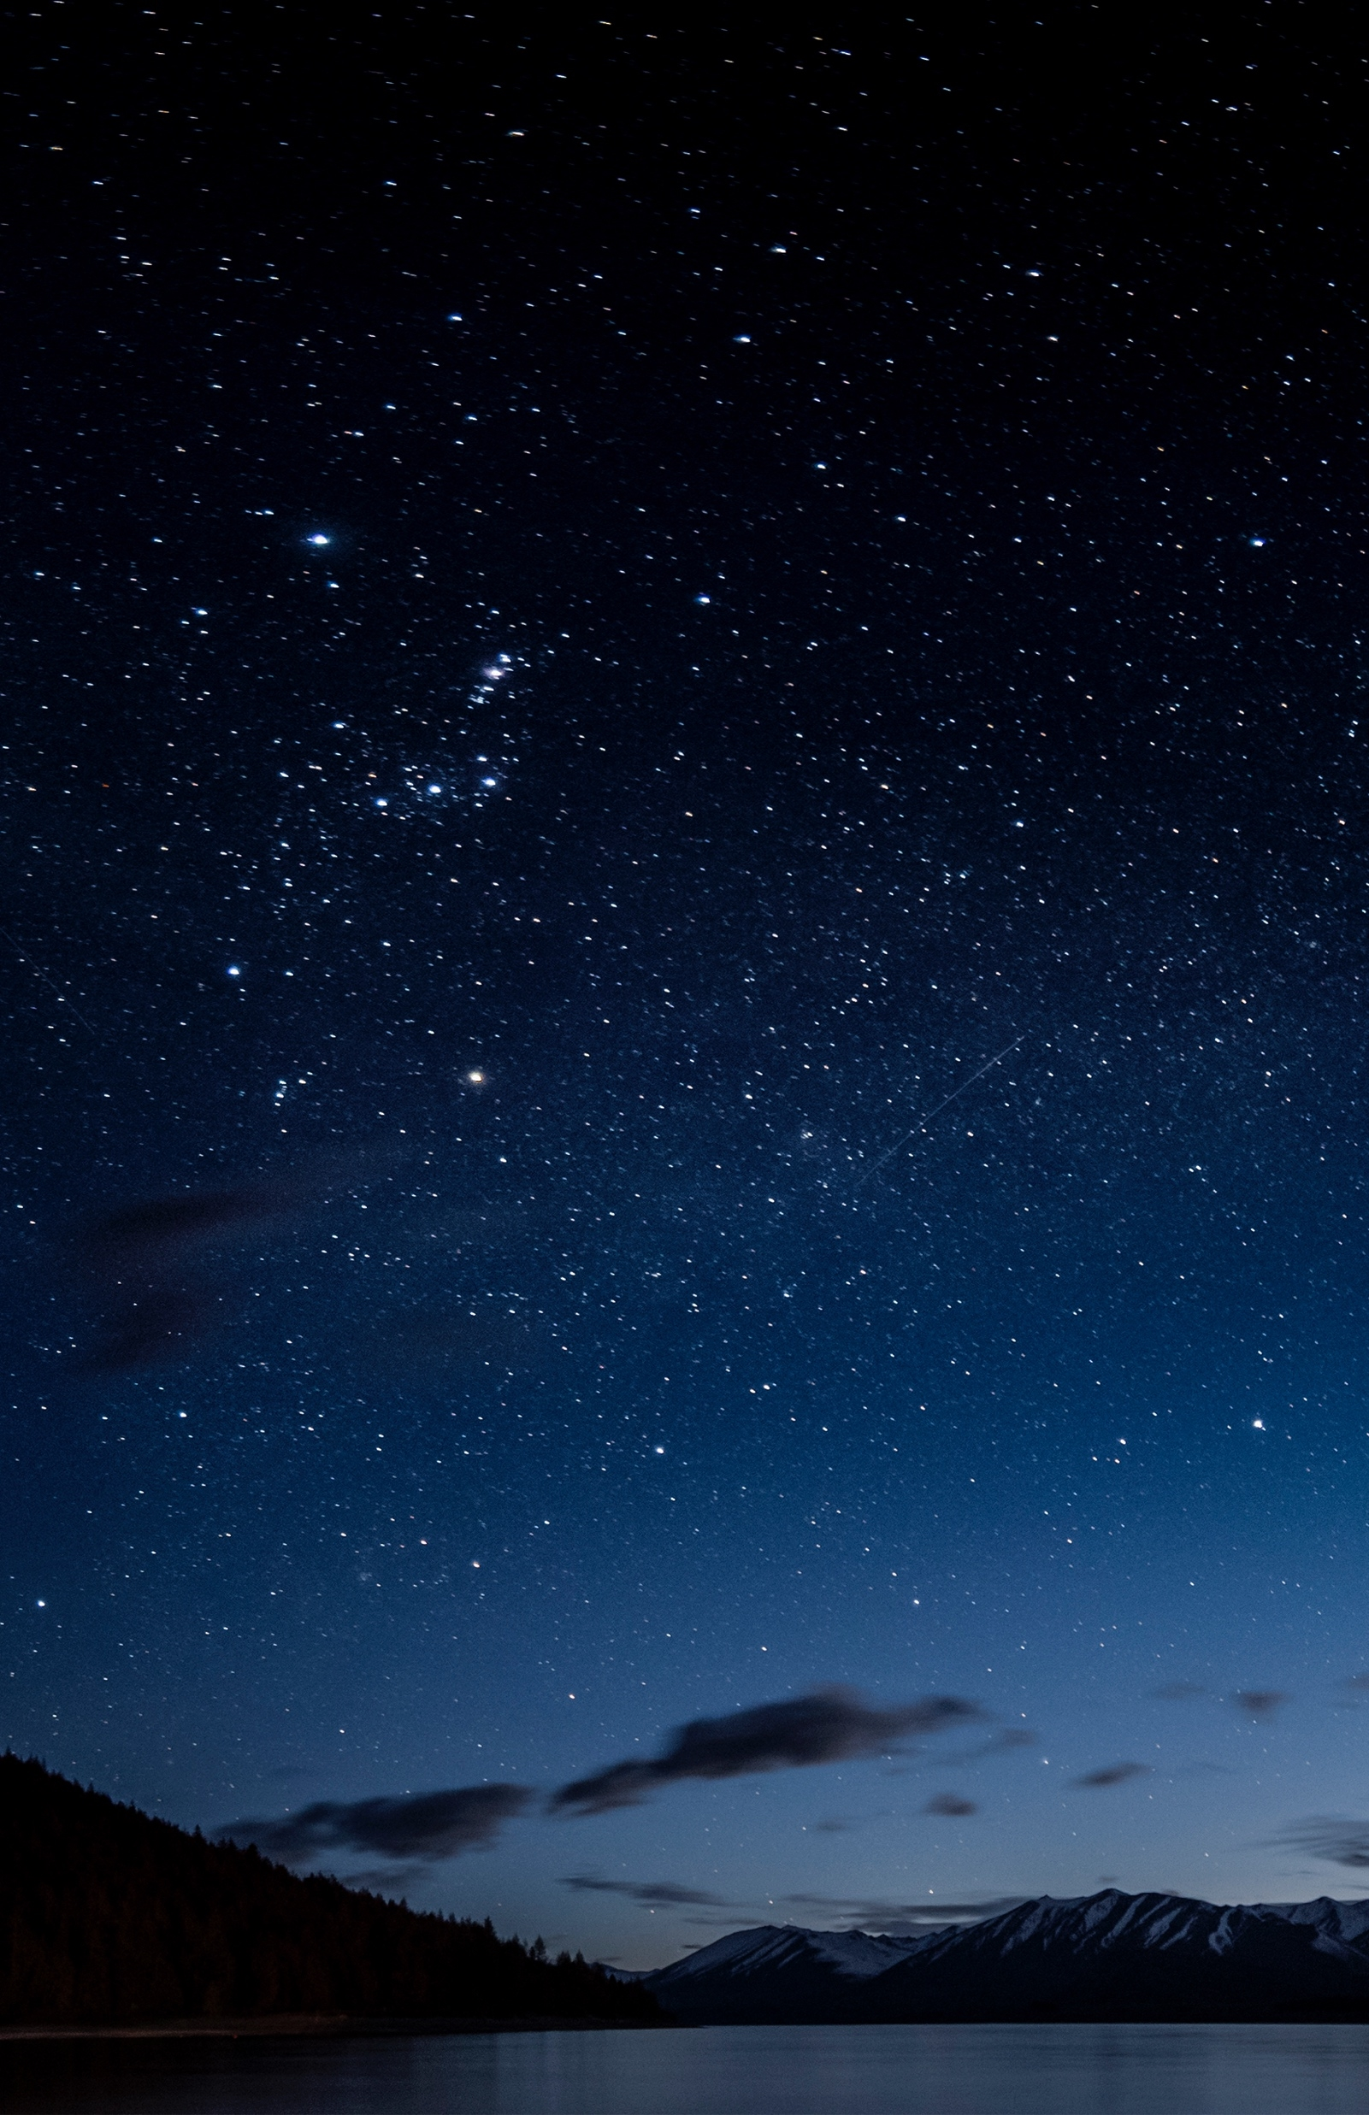
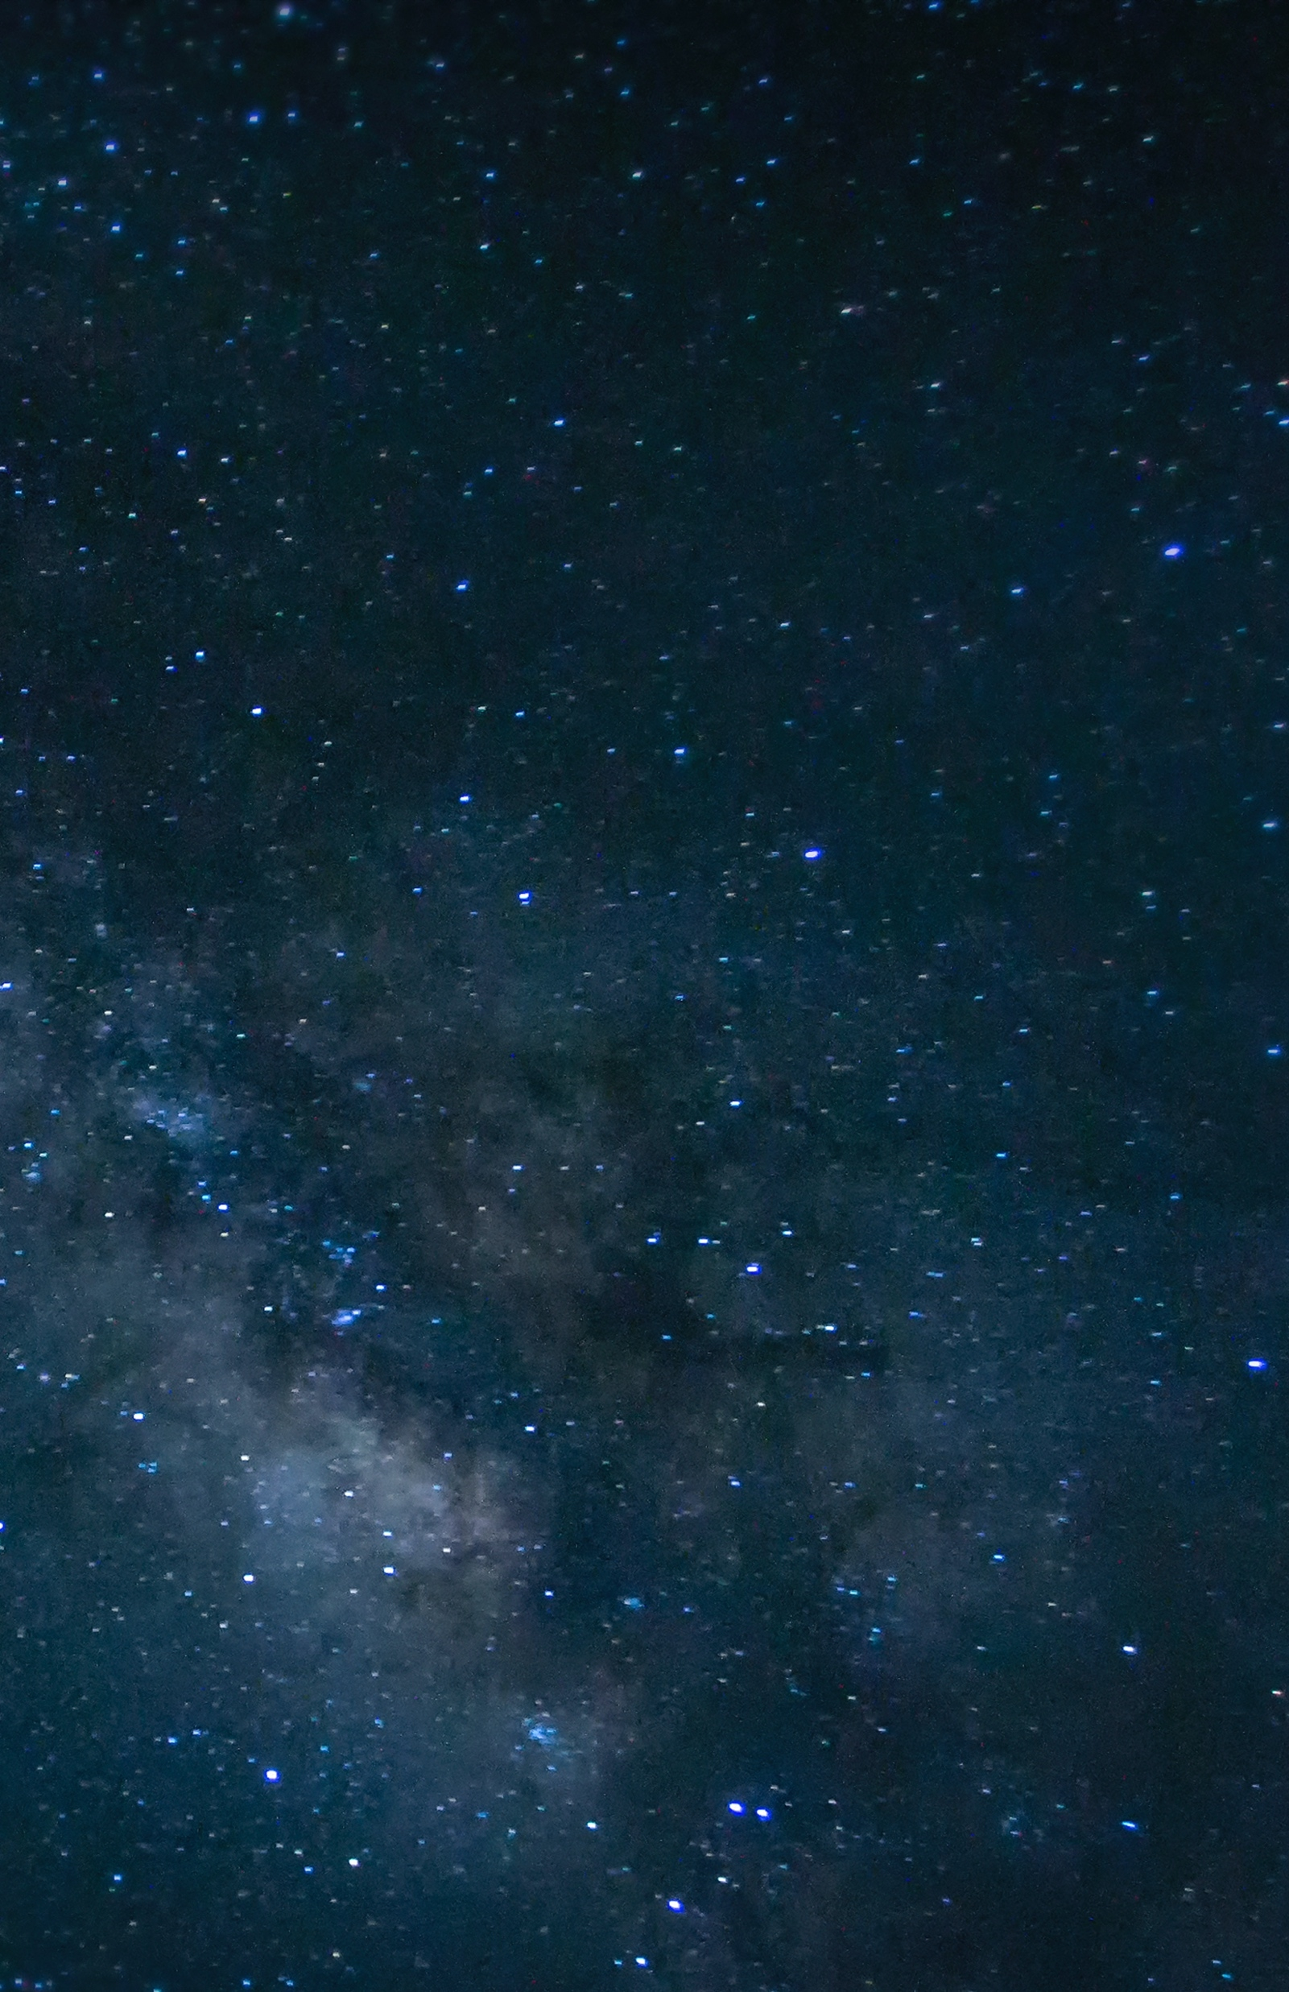

BEST DAD IN THE UNIVERSE
DAD, YOU MEAN THE WORLD TO ME
HAPPY FATHER’S DAY TO THE

